Slide 1
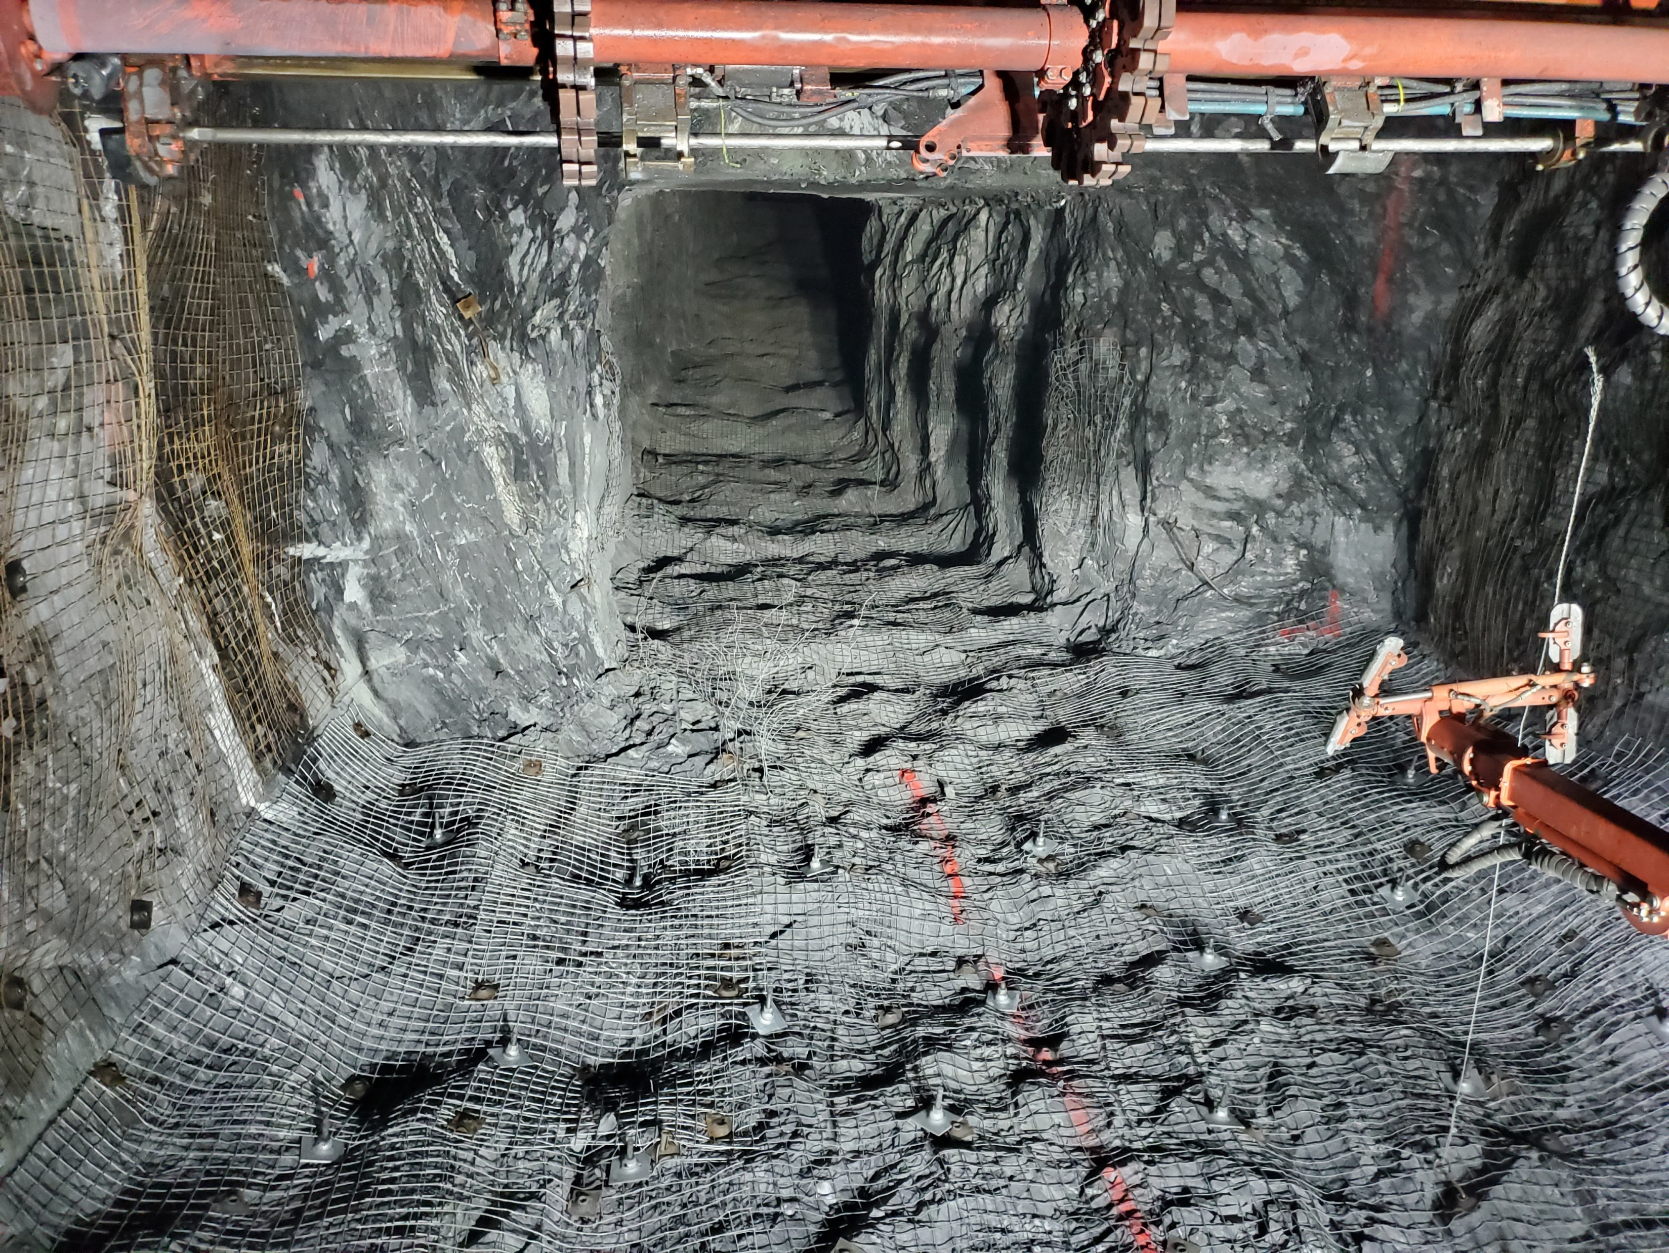
Planning for Infrastructure Projects in Extreme Environments
LSIC December Meeting
Seth Pollak, PE, PG
December 14, 2022

Slide 2
Our firm
Dedicated to sustainable development, Arup is a collective of more than 17,000 designers, advisors and experts working across 140 countries. Founded to be both humane and excellent, we collaborate with our clients and partners using imagination, technology and rigor to shape a better world.

Slide 3
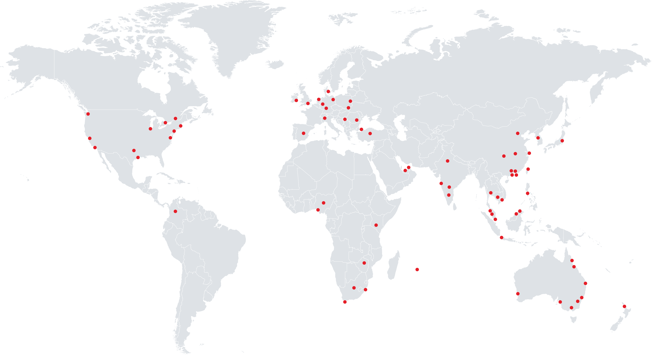
Global presence
89 offices
33 countries
$2.2bn* revenue
of independent ownership
75 yrs
17,000+ people
as at Mar 2021 *19/2020 financial year
Notes:
US$2.2bn turnover in 2020 (from 2020 Annual Report)

Slide 4
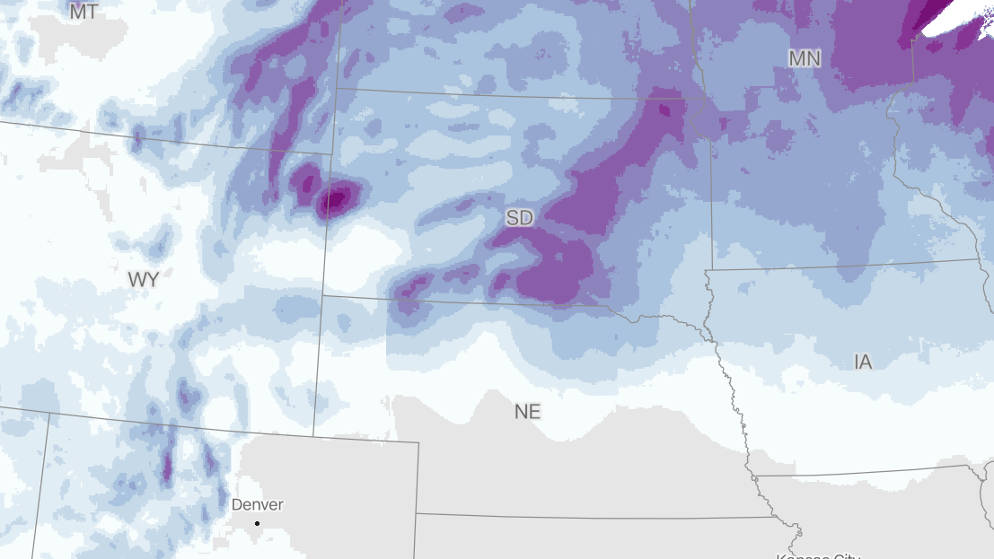
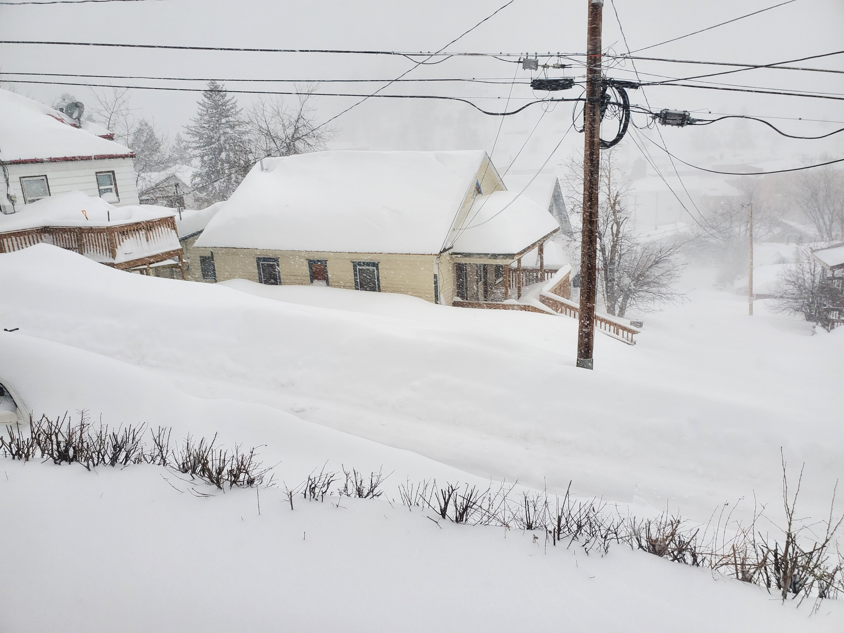
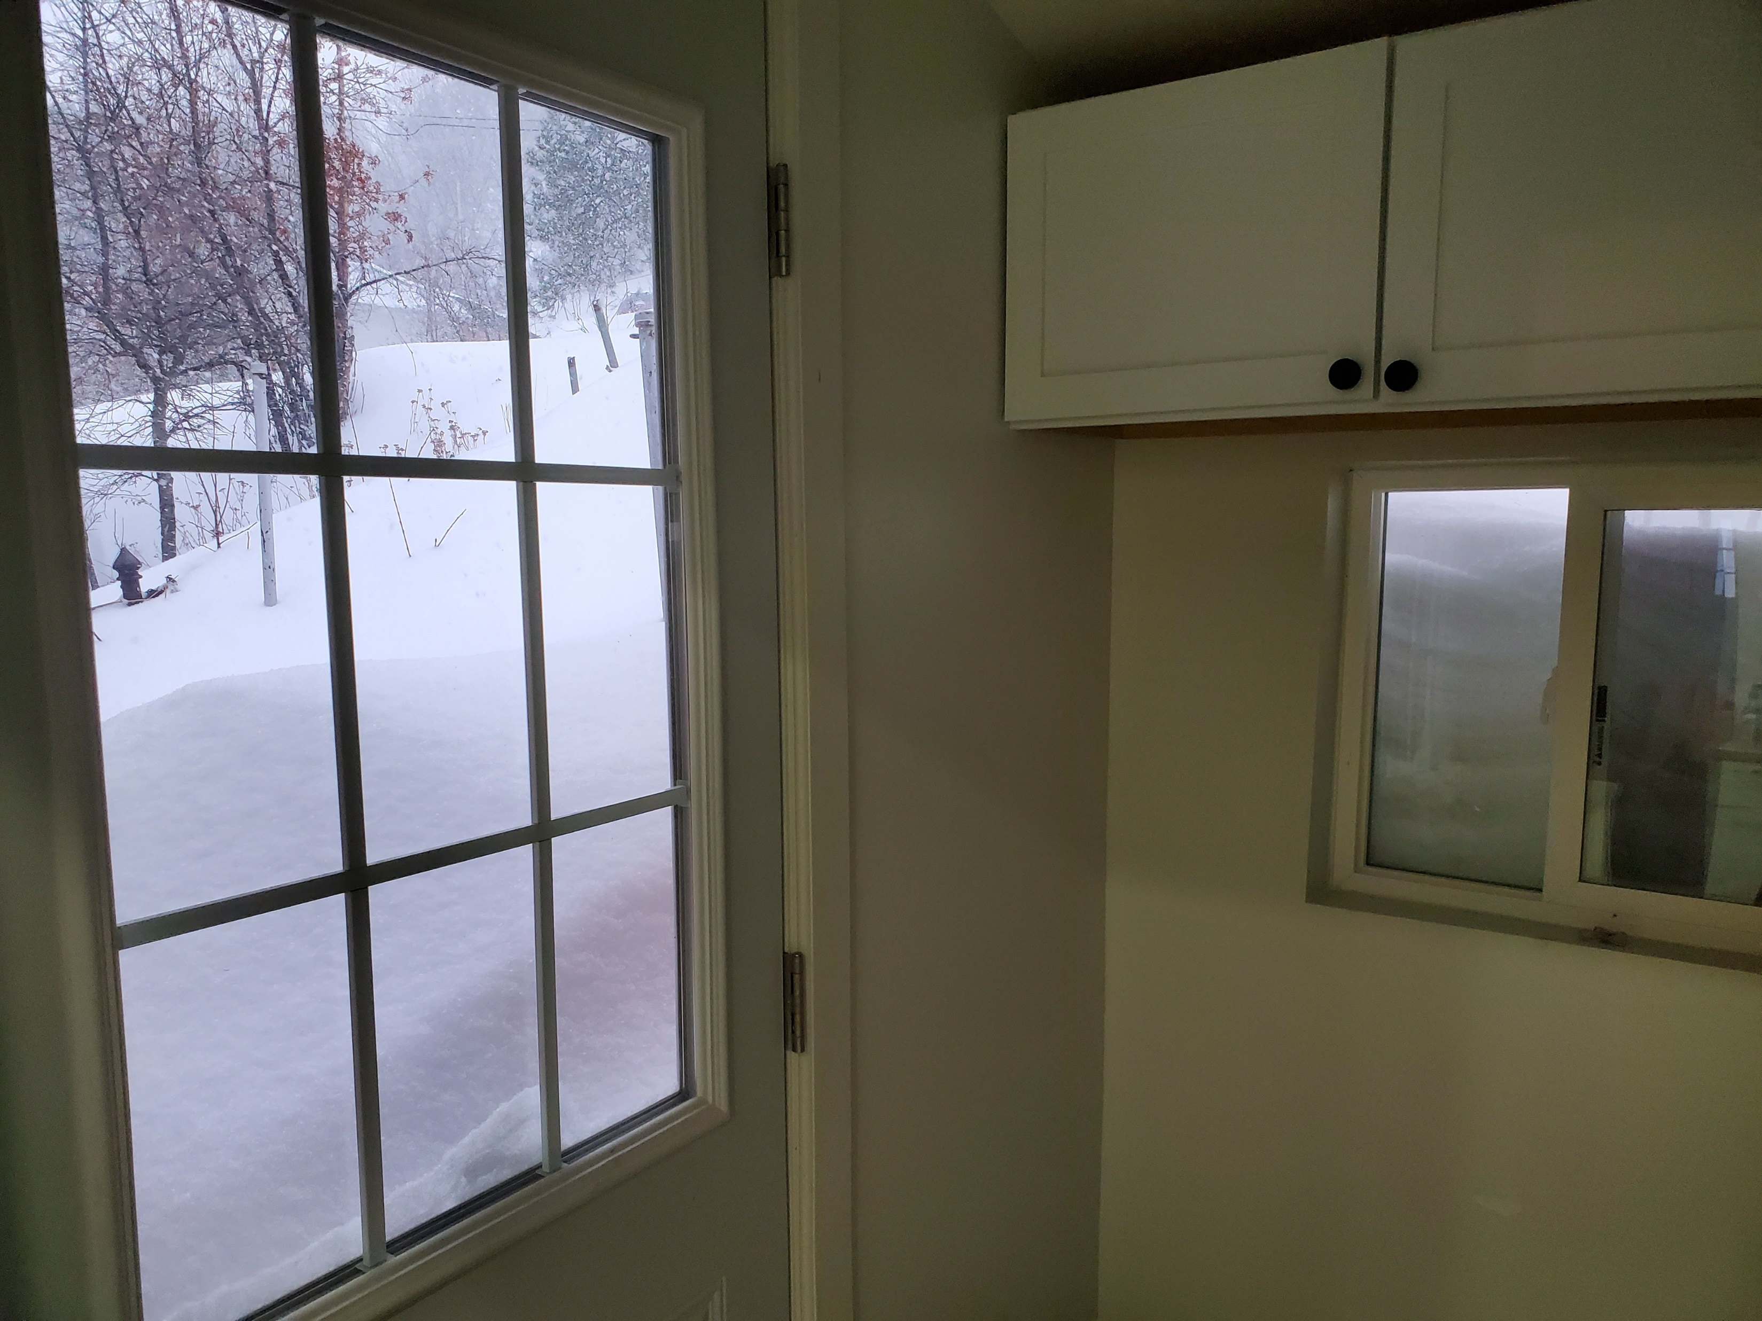
Extreme Environment?
Current Weather in South Dakota

Slide 5
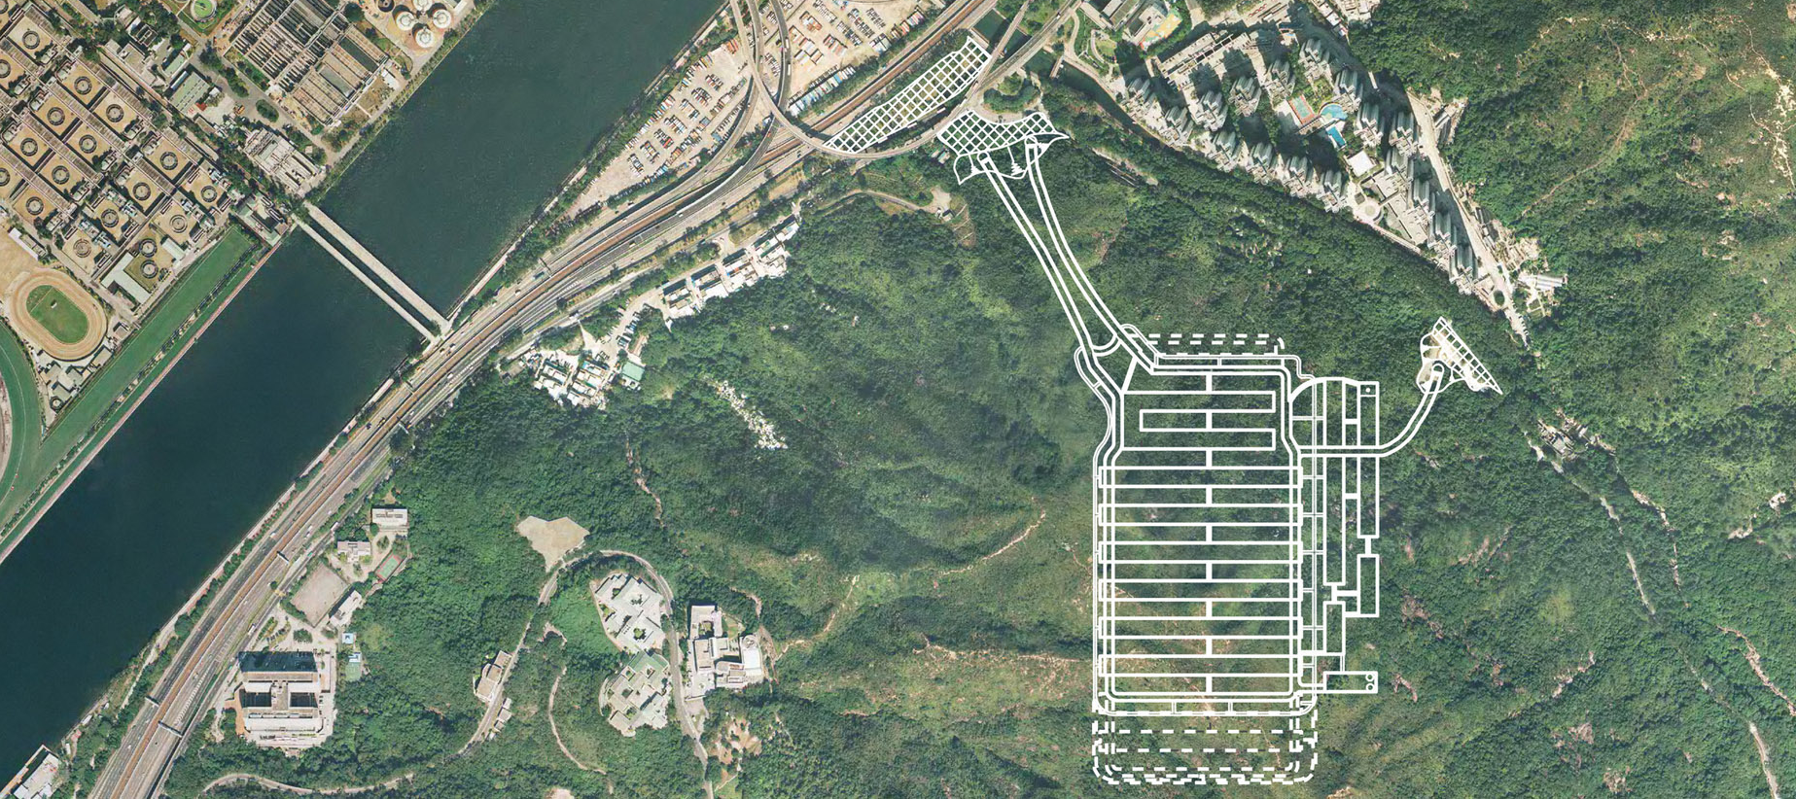
Underground Space Development
Underground space is much more than linear infrastructure (road/water/rail tunnels)
Science (deep neutrino labs)
Hydrogen Storage
Deep Shafts
Storage (archives/waste)
Wastewater treatment
Nuclear waste
Sports?
A strategy to promote the use of underground space in Hong Kong - Arup

Slide 6
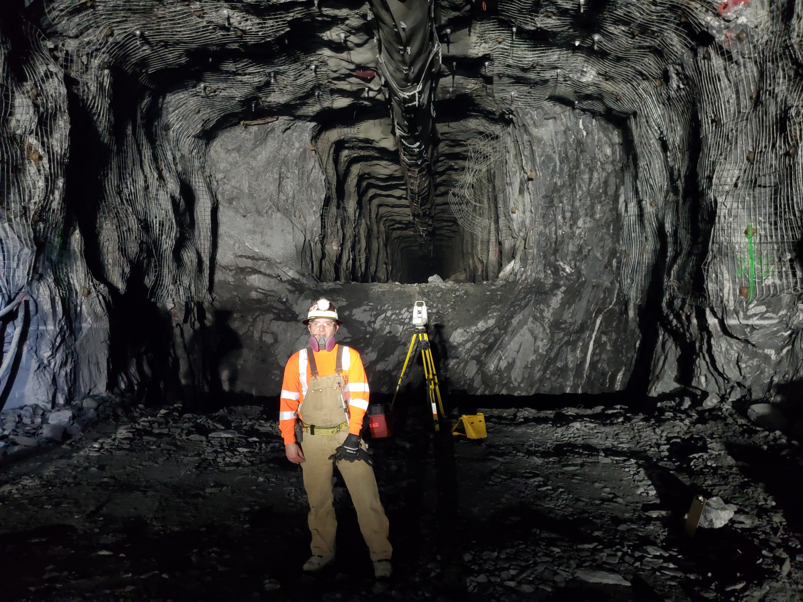
What Constitutes an Extreme Environment?
Location (rural/city, climate, access to transportation networks – labor/materials)
Depth (civil vs mining)
Geomaterials (stress, water/frozen, contamination) – these may result in complex behaviors not adequately captured by “standard” soil or rock models
Safety (gas, explosives)
What are the constraints around construction – means/methods
Third parties and influences

Slide 7
The Pursuit
Why pursue? We look for projects that will be useful and benefit our whole society, not just a portion of it. Sustainable and humane.
All projects have risks – beyond commercial exposure, we consider the following:
-uniqueness
-ability to build knowledge base
-required technology and workflow/resources
-environmental consequences
-reputational
-risk sharing model (owner/engineer/contractor/third parties)

Slide 8
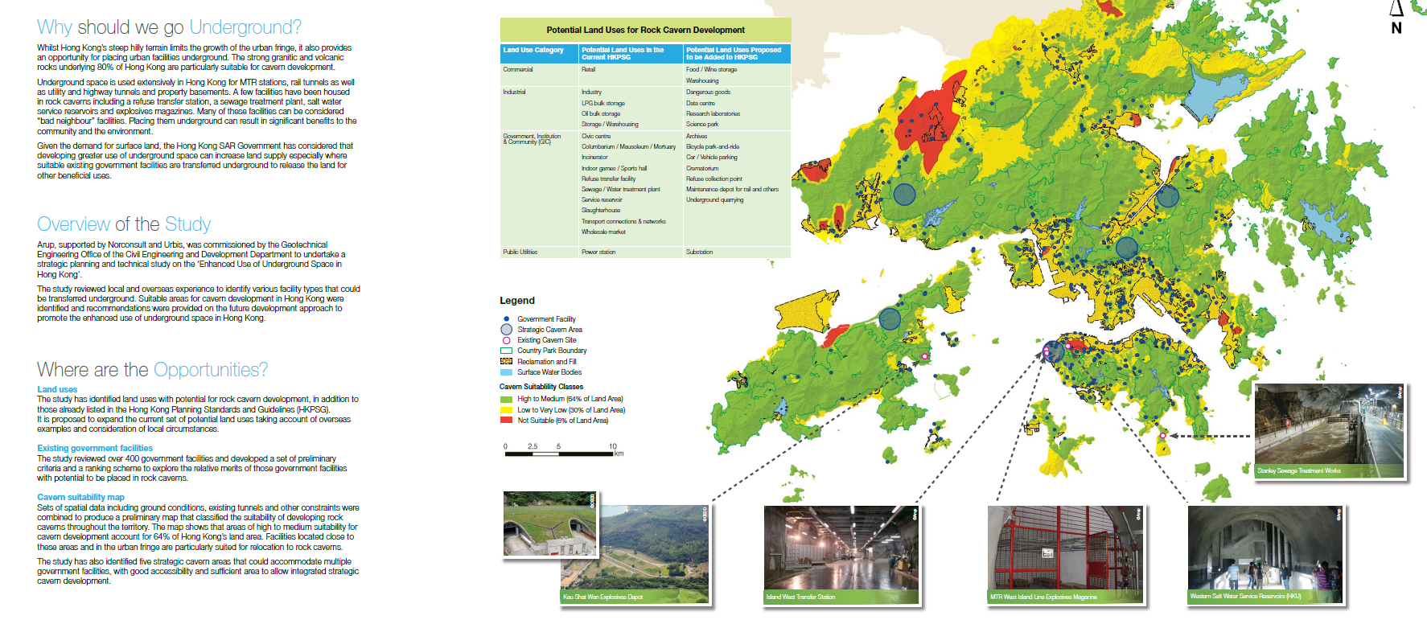
Planning
“The idea was to better integrate facilities, so people can easily move between them, and avoid the conflicts of traffic and weather disruptions above ground,” said Mark Wallace, director of infrastructure at consultancy Arup.
HK Enhanced Use of Underground Space Feasibility Study

Slide 9
General Design Process
Staged design – (concept, preliminary, final); build up knowledge base incrementally, cannot move to next stage until body of knowledge has been expanded
Fatal Flaws – look for the fatal flaw at each stage
Benchmarking – consider relevant or similar projects and their risks, but cannot be relied upon to reflect the design (e.g. subtle differences may lead to major design changes)
Failure mechanisms
Reviews at each milestone (independent, internal)
Early onboarding of Contractor (after concept?) can add value, find flaws, reduce risk and changes – particularly useful if unique environment

Slide 10
Design in Extreme Environments
Maximize reuse/refurbishment – make this part of the design criteria
If no benchmarking, need to be able to replicate the environment in lab or scaled test trial for materials and soils - ultimately, the design methods need to be validated
Ability to change or alter the in situ conditions to something more favorable (ground treatment)
Extends beyond traditional geo-engineering – considerations of logistics, suppliers and supply chain, labor and skills, equipment required to satisfy project requirements.
Validation during construction, monitoring

Slide 11
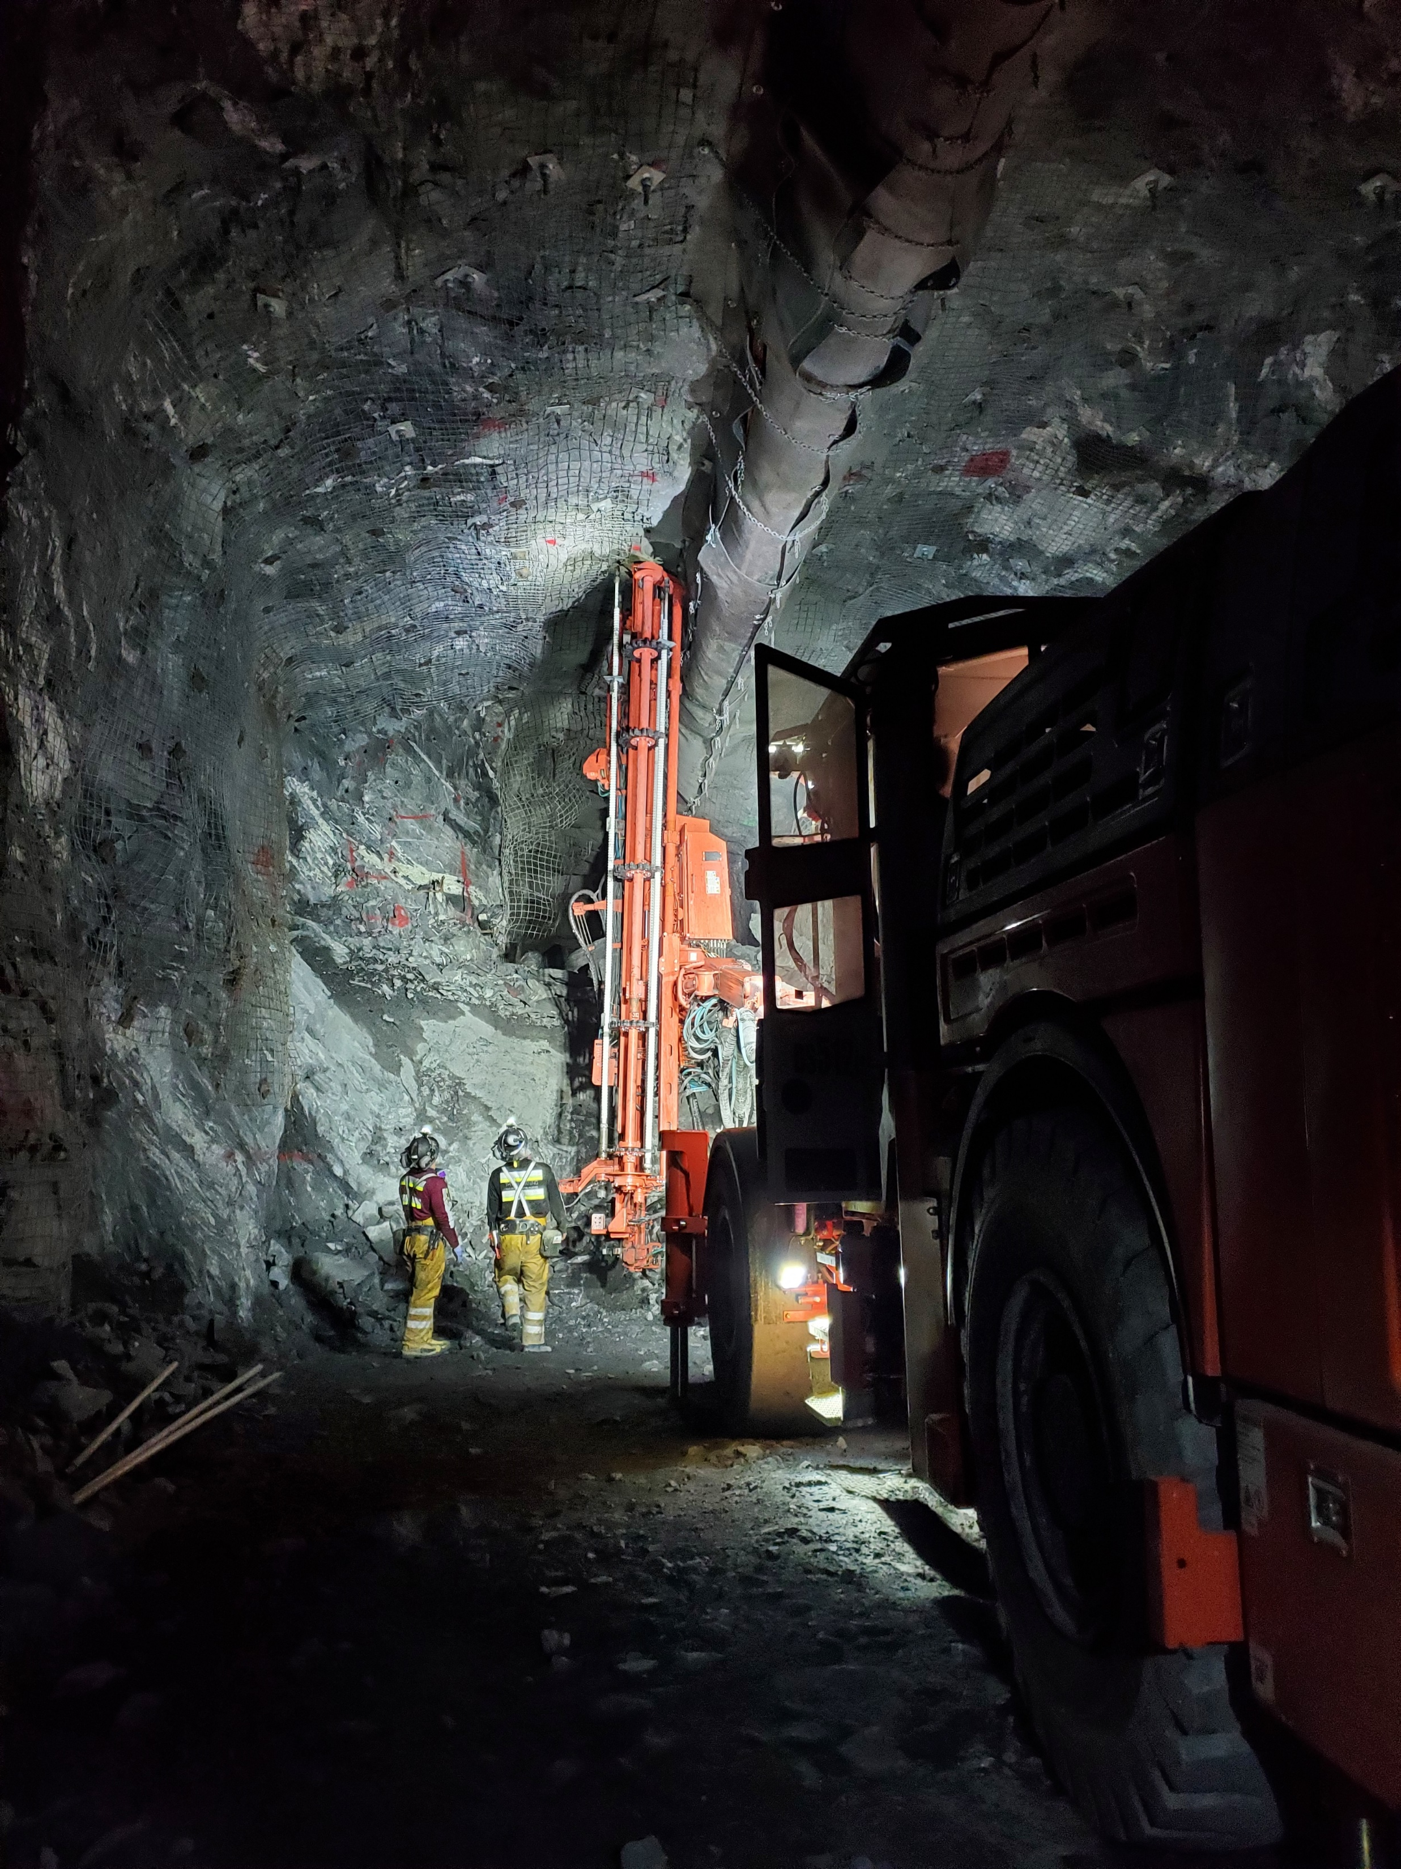
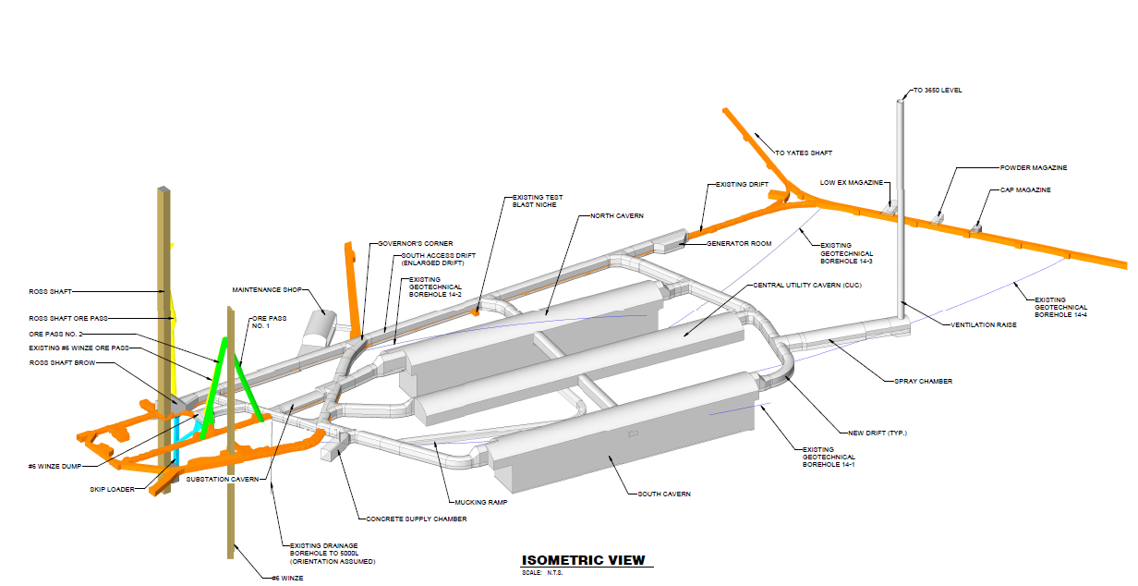
LBNF Project
Lead, South Dakota

Slide 12
Project Definitions vs Design Stages
Concept: established bookends on feasible geometry, used existing geotechnical data, simple ground models
Preliminary: site specific data collection, targeted at identifying “showstoppers”, lab testing, blast trials to evaluate third party impacts, rock mass characterization and ground support requirements, onboard contractor, combined risk register
Final: refinement, build in detailed sequencing and align with ground support, confirm means/methods, establish trigger actions and response plan
Construction: validate through I&M, mapping, respond to changes

Slide 14
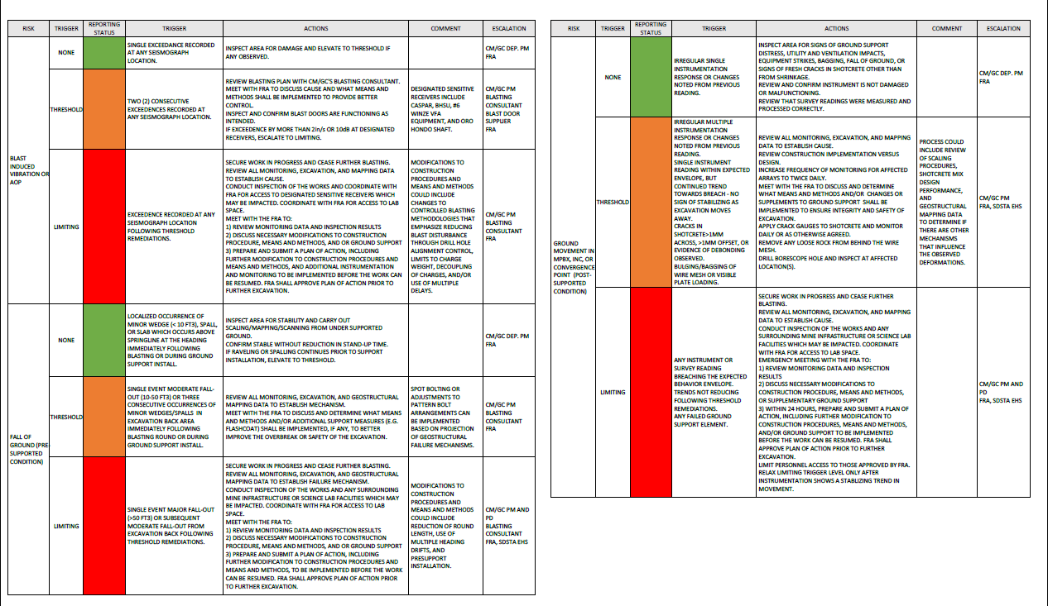
Risk and Mitigation in Design
Trigger Action and Response Plan (TARP) in Contract Drawings
Aligned with Geotechnical Baseline Report for ground behavior
Sets expectations and course of action for each party upon occurrence (or repeated occurrence) of a geotechnical risk item
Contractor is made aware of not only number of events, but the remediation actions as well

Slide 15
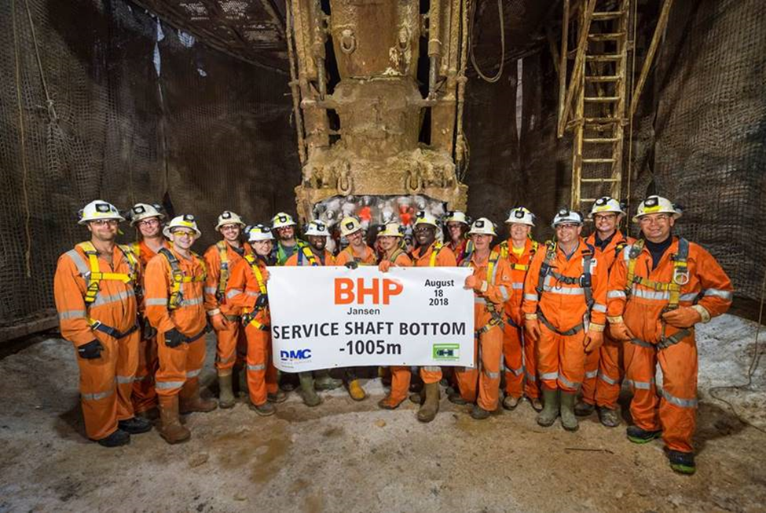
Deep Shafts for Potash
Rural, tundra like conditions
Twin shafts, 1000m deep
Larger diameter than precedent shafts in the area – how much to rely on benchmarks?
Underground water reservoirs required a 700m deep artificial ground freeze!
Initially, poorly understood (empirical) ground-structure interaction with new excavation technology

Slide 16
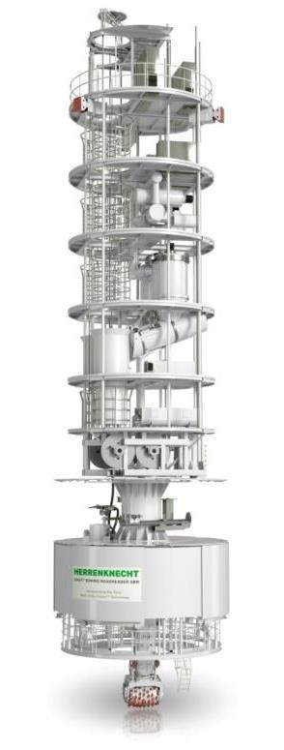
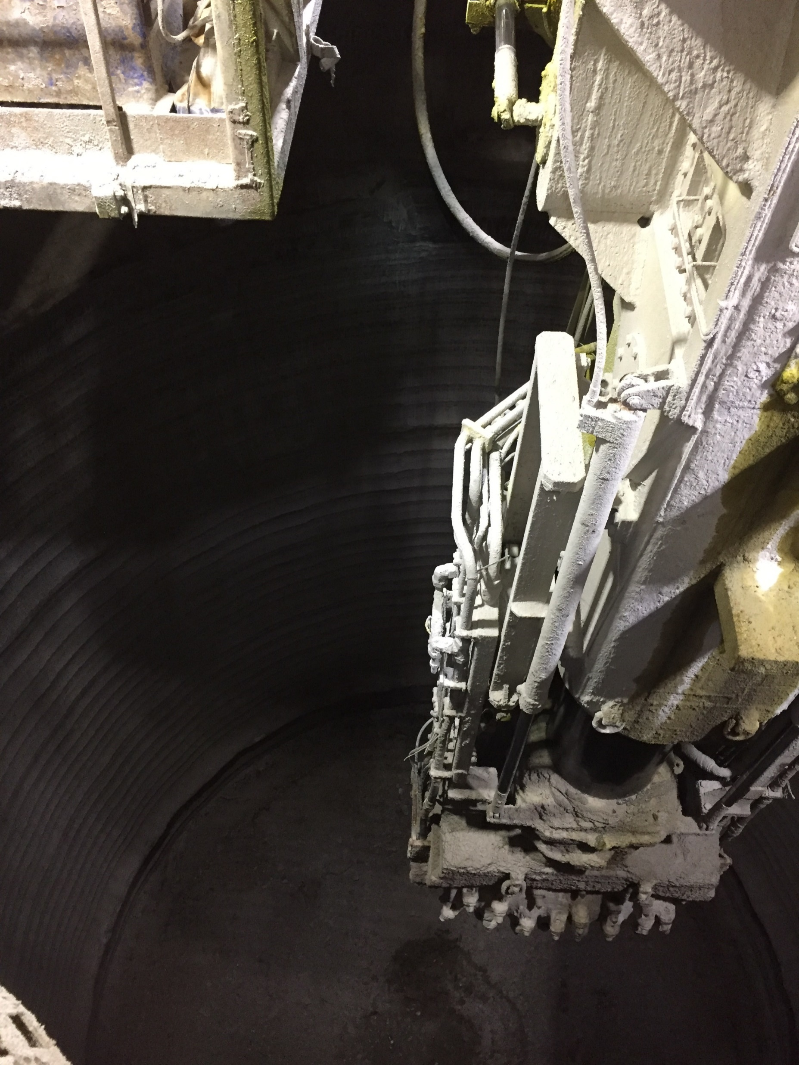
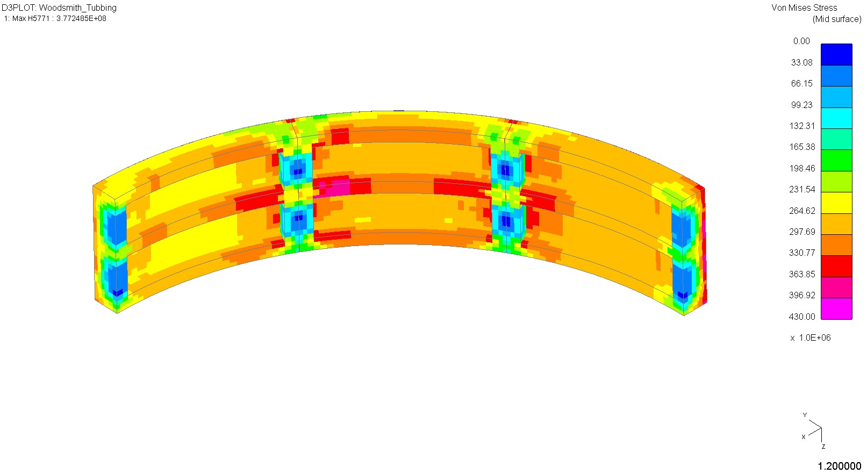
A Change in Process…
New technology driven by safety (mechanization)
Ground property “improvement”
Unintended consequences?
Performance Based Design – challenge code based on modern constitutive models and analysis methods
Stop and assess (but time is money!), measure/observe, new theory, re-calibrate, proceed – scientific method in action

Slide 17
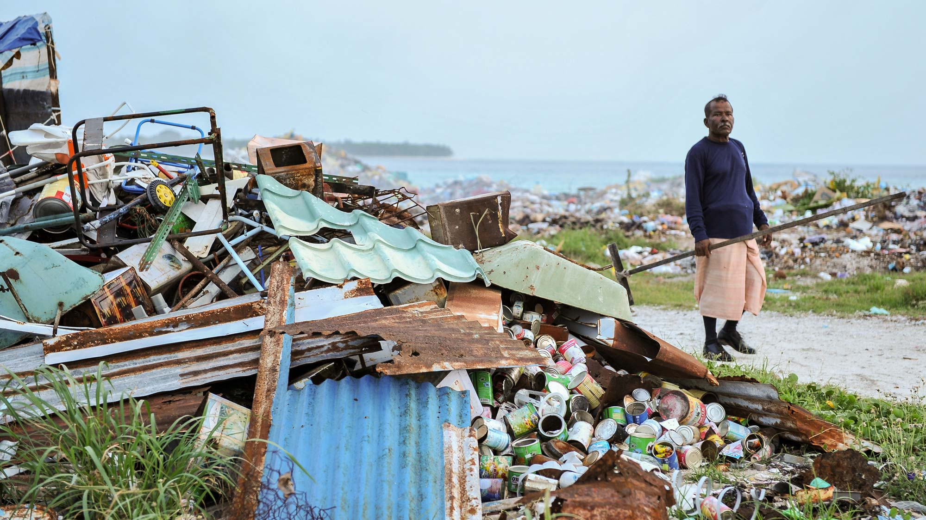
Resilience Based Design
Codes focused on ensuring minimum life safety after extreme events (seismic, wind, blast, wave)
But how do you recover quicker after such events? e.g. limit damage
REDi is a set of prescriptive guidelines and rating system for owners, engineers, and architects to implement resilience-based design to achieve beyond-code resilience objectives – continued functionality along with life safety

